Slide 1
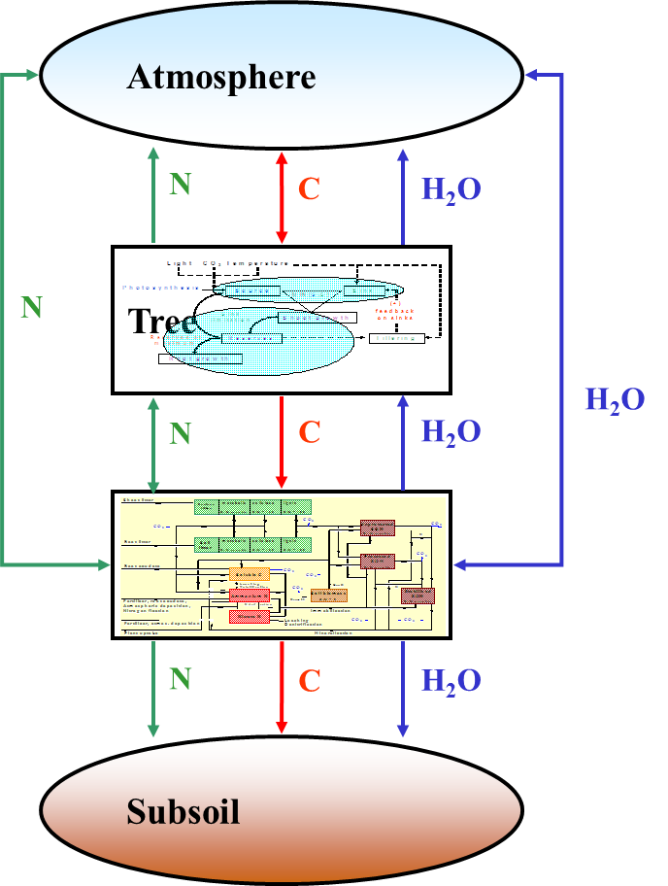
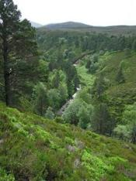
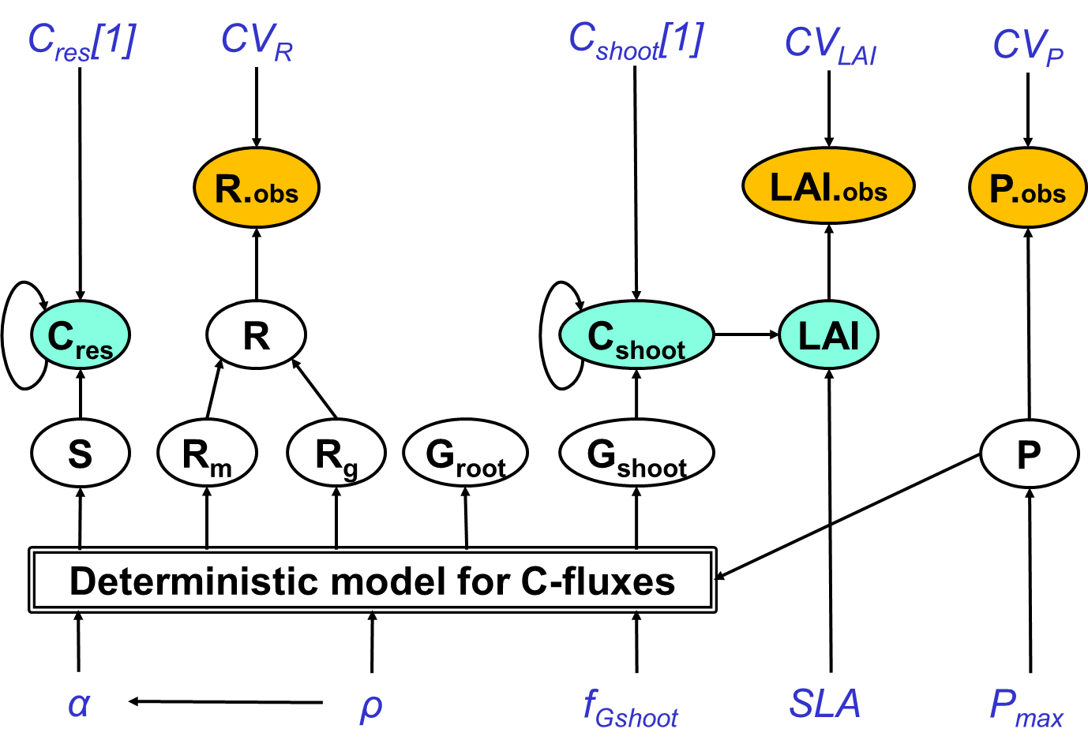
Bayesian Methods for Ecological and Environmental Modelling: COMMUNICATION
Marcel van Oijen, Lindsay Banin, David Cameron, Peter Levy, Kate Searle
CEH-Edinburgh, 2019-09-12

Slide 2
Contents
Introduction
Co-design & graphical modelling
Reporting results
Visualisation of uncertainty
Discussion

Slide 3
1. Introduction

Slide 4
1.1 Purpose , ToWhom-What-How, Guidelines?
Decision-support
What is the purpose of the communication?
Are you co-designing a model, or is the study finished and are you reporting results?
Graphical modelling is very good for the first purpose, less so for the second
Reporting results: To whom? What? How?
Are there guidelines for visualising uncertainty?

Slide 5
2. Co-design & graphical modelling

Slide 6
2.1 Decision-support
How to make LS-modelling useful for decision-making?
Stimulate involvement of stakeholders
Recognise uncertainties
Production or conservation?
Gonzales-Redin et al. (2016)

Slide 7
2.2 Production or conservation? GIS + BBN
GIS: inputs
BBN: conditional probabilities
GIS: outputs
Gonzales-Redin et al. (2016)

Slide 8
Impacts of Brexit scenarios on UK food prices using structured expert judgement
Barons & Aspinall (2019)

Slide 9
3. Reporting results

Slide 10
3.1 Reporting: To whom? What? How
Reporting to whom?
Colleagues or stakeholders? Listeners, readers (posters or papers), or app-users?
What?
Main message: methodological <-> application?
Checklist: Reporting prior, likelihood, algorithm, software, quality test of MCMC, posterior parameter uncertainty, posterior predictive uncertainty
E.g.: beta priors, Gaussian likelihoods for residuals from PBM, Metropolis, BayesianTools, Gelman-Rubin < 1.01, Posterior histograms parameters, Posterior prediction bands for output variables
How?
Text, tables, figures, interactive app

Slide 11
4. Visualisation of uncertainty: Guidelines

Slide 12
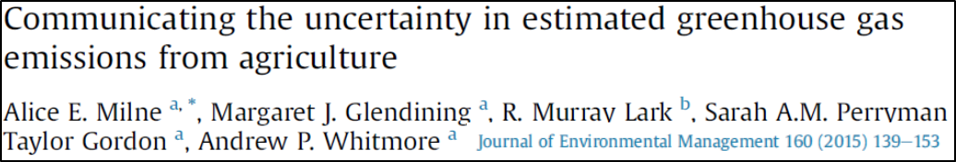
Milne et al. (2015): Communicating the uncertainty in GHG emissions
Histograms
Shaded arrays
Boxplots

Slide 13
Milne et al. (2015): Communicating the uncertainty in GHG emissions

Slide 14
Milne et al. (2015): Communicating the uncertainty in GHG emissions

Slide 15
Milne et al. (2015): Communicating the uncertainty in GHG emissions

Slide 16
Milne et al. (2015): Communicating the uncertainty in GHG emissions

Slide 17
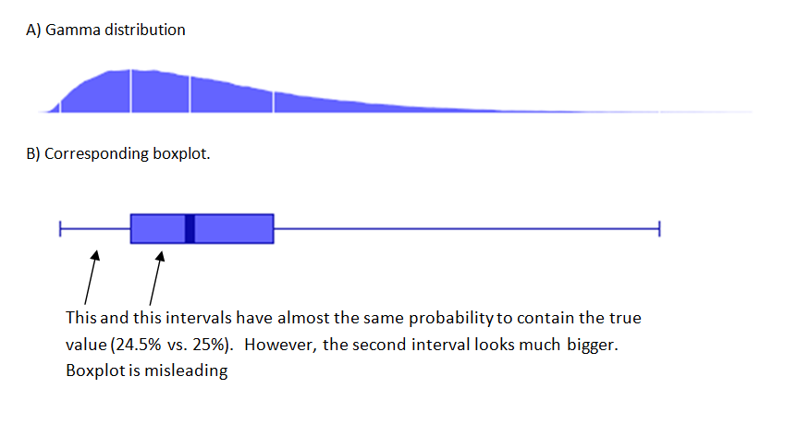
PRINCIPLES OF POSTERIOR VISUALIZATION (2015)
Blog by Mikhail Shubin:
https://ctg2pi.wordpress.com/2015/02/24/principles-of-posterior-visualization/

Slide 18
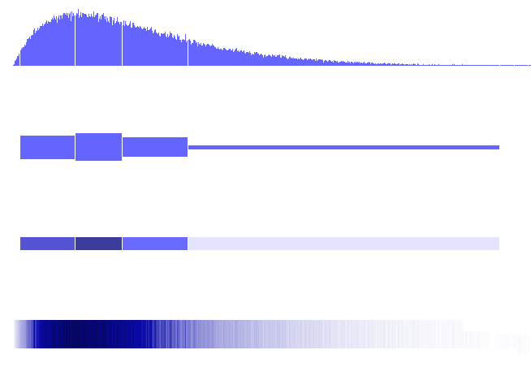
PRINCIPLES OF POSTERIOR VISUALIZATION (2015)
Principle: Equal probability = Equal ink

Slide 19
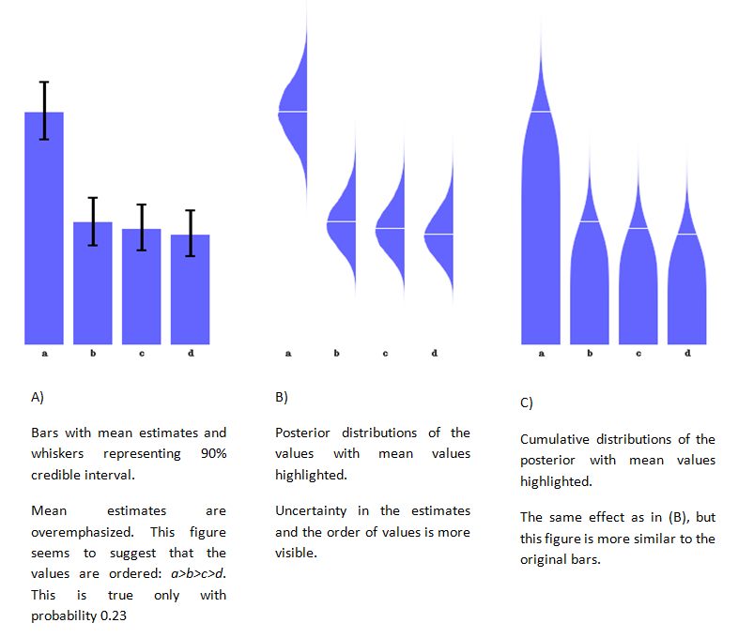
PRINCIPLES OF POSTERIOR VISUALIZATION (2015)
Principle: Do not overemphasize the point estimate

Slide 20
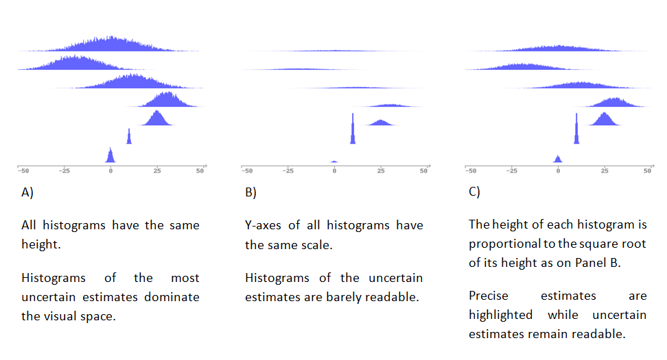
PRINCIPLES OF POSTERIOR VISUALIZATION (2015)

Slide 21
Kleineberg et al. (2019): Visualizing Uncertainty

Slide 22
Kleineberg et al. (2019): Visualizing Uncertainty

Slide 23
Kleineberg et al. (2019): Visualizing Uncertainty

Slide 24
Kleineberg et al. (2019): Visualizing Uncertainty

Slide 25
Kurz-Milcke et al. (2008): Transparency in Risk Communication

Slide 26
Spiegelhalter et al. (2011): Visualizing uncertainty about the future

Slide 27
Van der Bles et al. (2019): Communicating unc. about facts, numbers and science

Slide 28
Gabry et al. (2018)

Slide 29
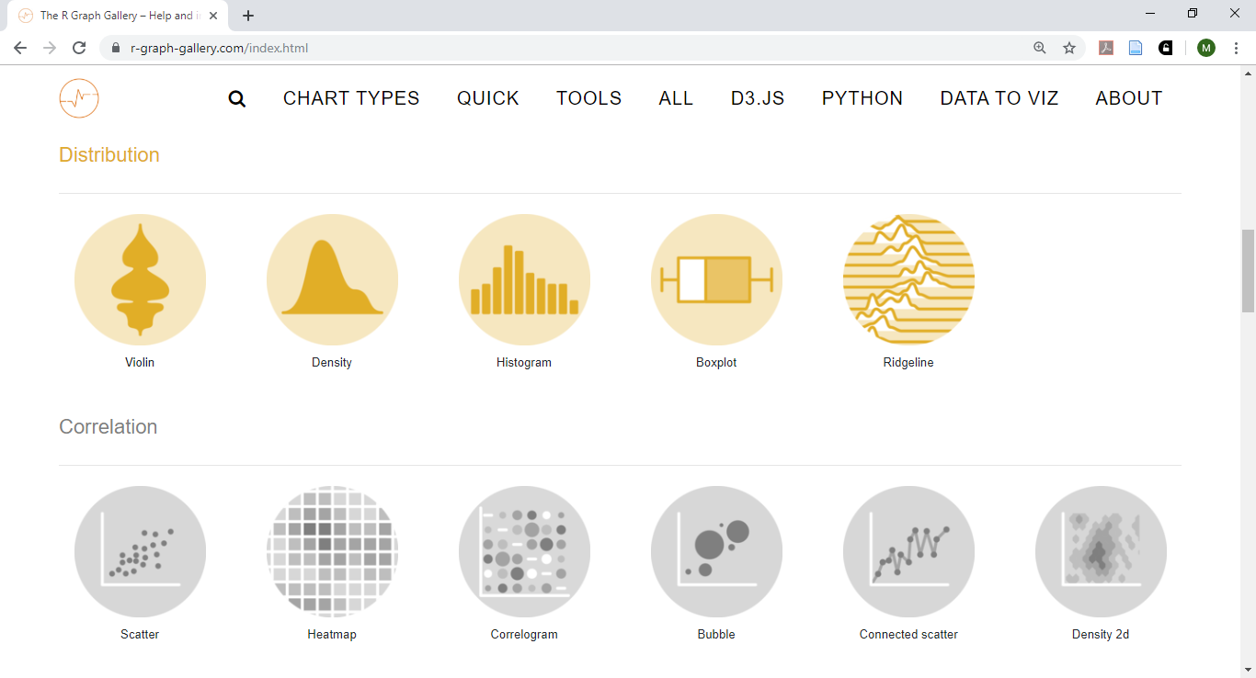
The R Graph Gallery: https://www.r-graph-gallery.com/

Slide 30
4. Visualisation of uncertainty: Examples CEH

Slide 31
3.8 Using data in Bayesian calibration of BASFOR
Prior pdf
Bayesian
calibration
Data
Posterior pdf

Slide 32
3.11 Parameter correlations
39 parameters
39 parameters

Slide 33
3.11 Maps of (1) predictions, (2) uncertainties
C-sequestration (model output for 1920-2000)
Uncertainty of C-sequestration
Van Oijen & Thomson (2010) Climatic Change 103: 55-67

Slide 34
4.1 Site-specific vs. generic BC for European forest
RMS - ratio
RMS - ratio
Geographical distribution of NitroEurope nitrogen deposition monitoring sites. ENF: evergreen needle leaf forest; DBF: deciduous broadleaf forest
Generic BC
Site-specific BC
Cameron et al. (2018)

Slide 35
4.1 Site-specific vs. generic BC for European forest
RMS - ratio
RMS - ratio
Geographical distribution of NitroEurope nitrogen deposition monitoring sites. ENF: evergreen needle leaf forest; DBF: deciduous broadleaf forest
Generic BC
Site-specific BC
Cameron et al. (2018)

Slide 36
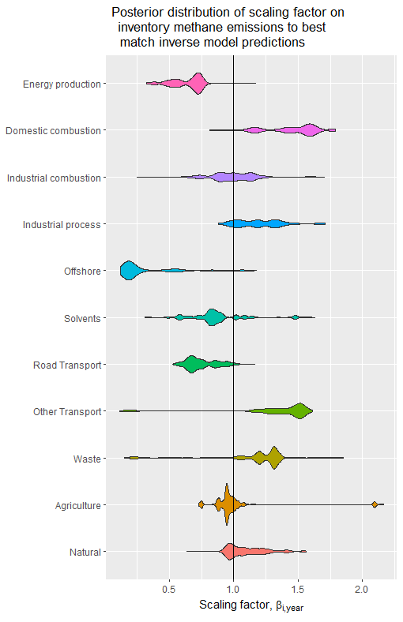
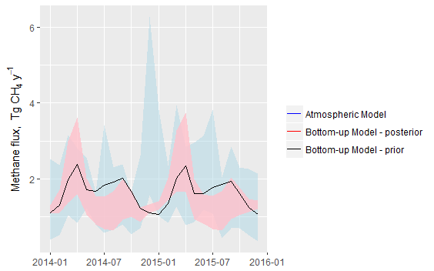
4.2 Reconciling LUC-inventory models with atmospheric inversion
Each emission sector has a characteristic spatial & temporal pattern
Use this in a Bayesian analysis of the parameters of a “bottom-up” model (anthropogenic & biogenic)
Derive sector-wise scaling factors = multipliers needed to match atmospheric model
Posterior distribution for methane shown (2014-2015)
Levy et al. (in prep.)

Slide 37
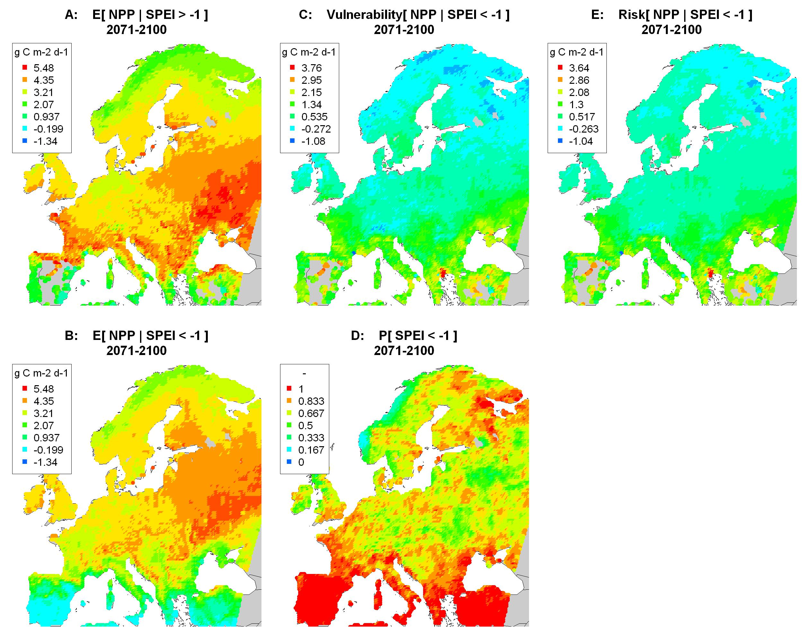
4.5 Drought-risk analysis for NPP in 2071-2100
Probability of drought (PH)
Risk (R)
= expectation of loss
R = P(H) V
Vulnerability (V)
Van Oijen et al. (2013, 2014)

Slide 38
3.8 Bayesian calibration of process-based models

Slide 39
INTERMEZZO
Shiny app for BELUC
Shiny app for MU-MAP

